Slide 1
Data 230 Term Project
Justin Wang

Slide 2
Goals
To find some of the factors that correlate with mortality rate
Through the use of visualizations, try to find explanations on why these correlate with mortality rates
To see if the factors analyzed are useful in terms of reducing mortality rates

Slide 3
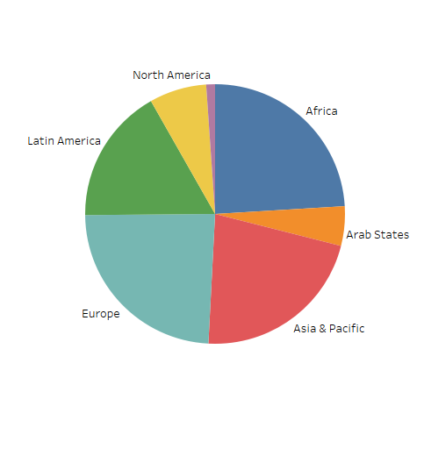
A note before we move on
Each region differs in the amount of countries it has. As a result, so of the results I use for analysis may be inaccurate.

Slide 4
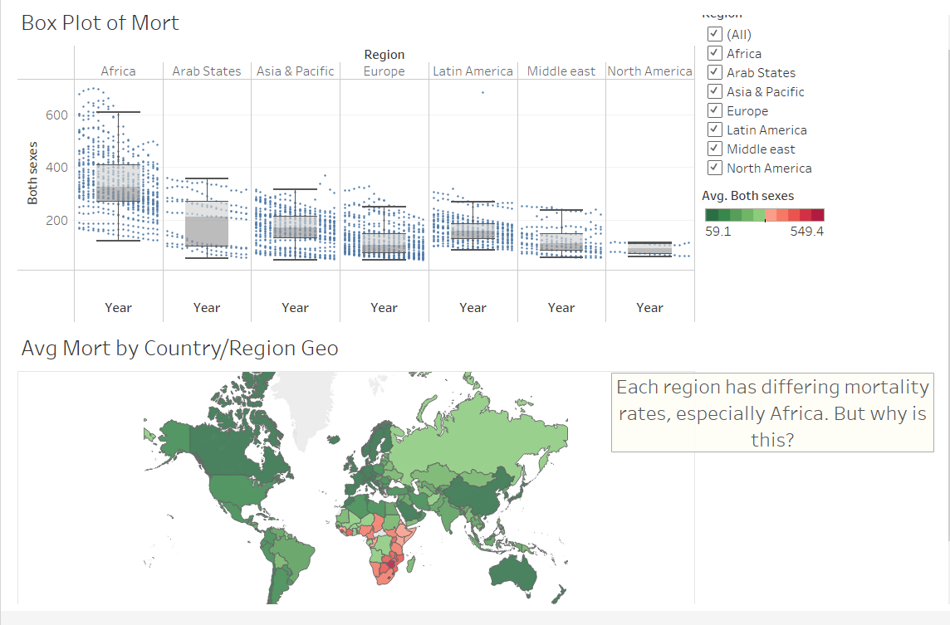
Problem
What causes the difference in mortality rates between regions, and how can we remedy this?

Slide 5
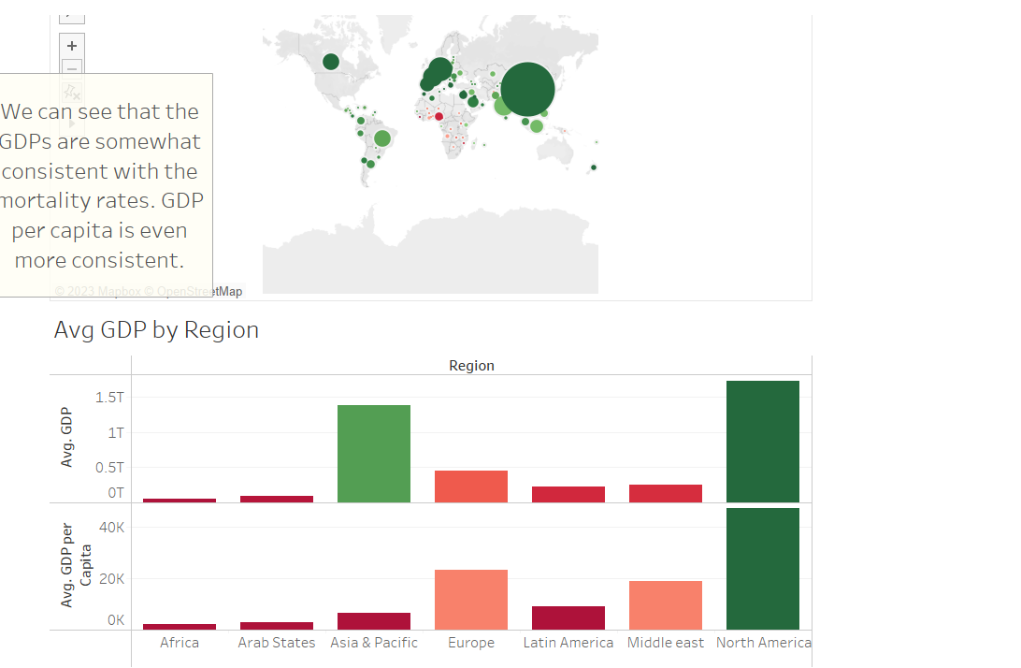
Is it the GDP?
Certainly, the GDP plays a role. When comparing these measures to the mortality rate before, it is somewhat consistent.
The GDP per Capita is also important and provides insights for cross country comparisons.

Slide 6
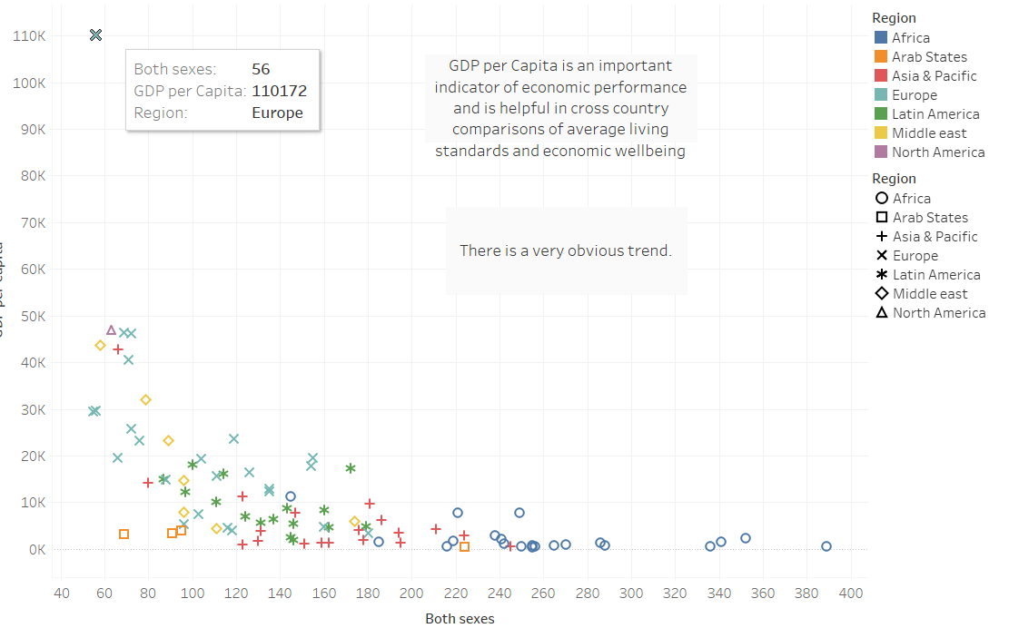
GDP per Capita v Mortality Rate
As mentioned before, GDP per Capita has a very obvious trend.

Slide 7
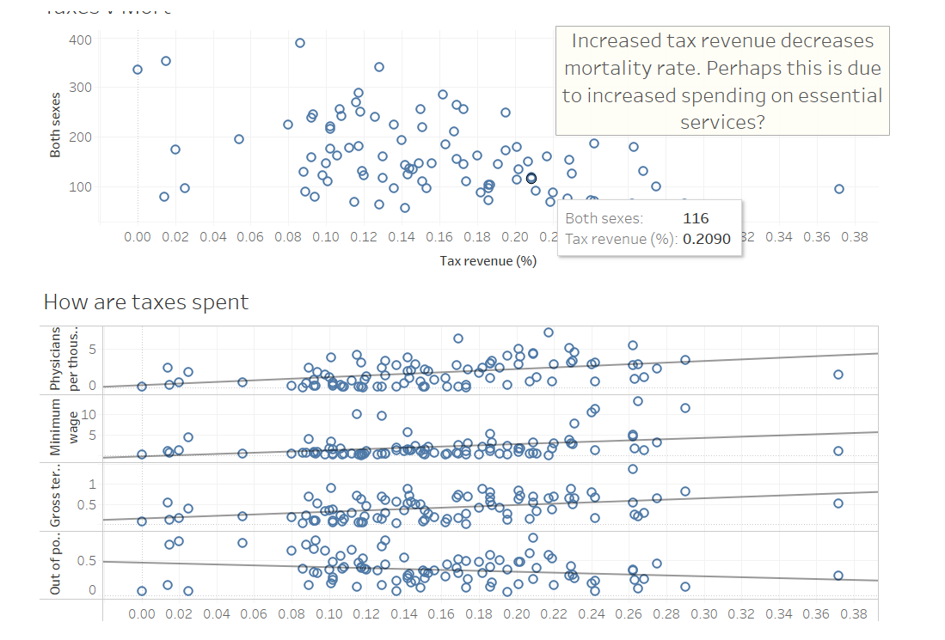
Spending Money
The richness of a country is important, but how money is spent is also important.
Higher tax revenues mean the country can spend more on essential services.

Slide 8
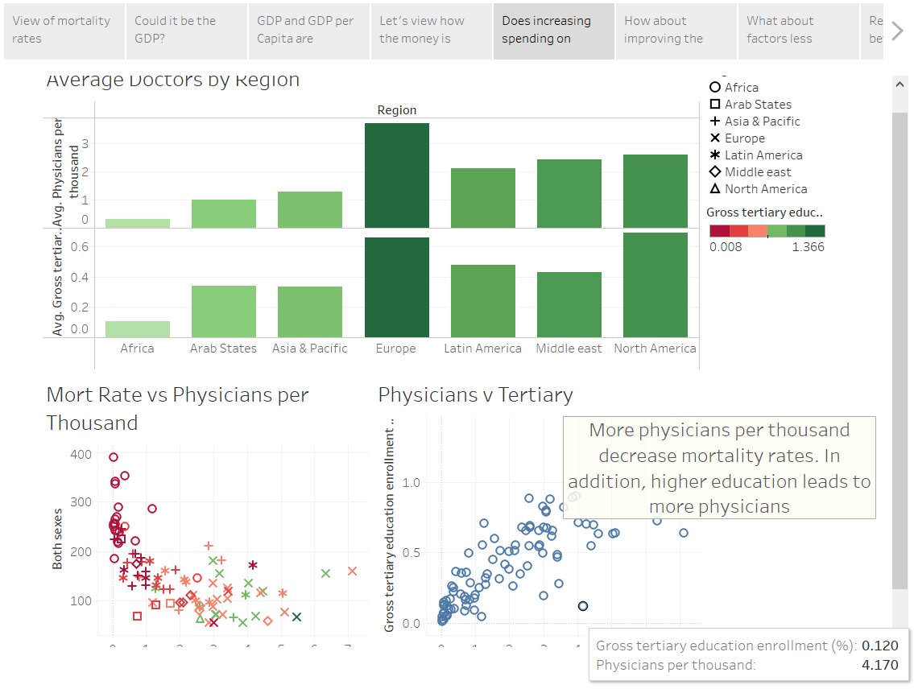
Accessibility
Physicians per thousand have a negative correlation with mortality rate.
Accessibility proves to be an important factor in reducing mortality rates.

Slide 9
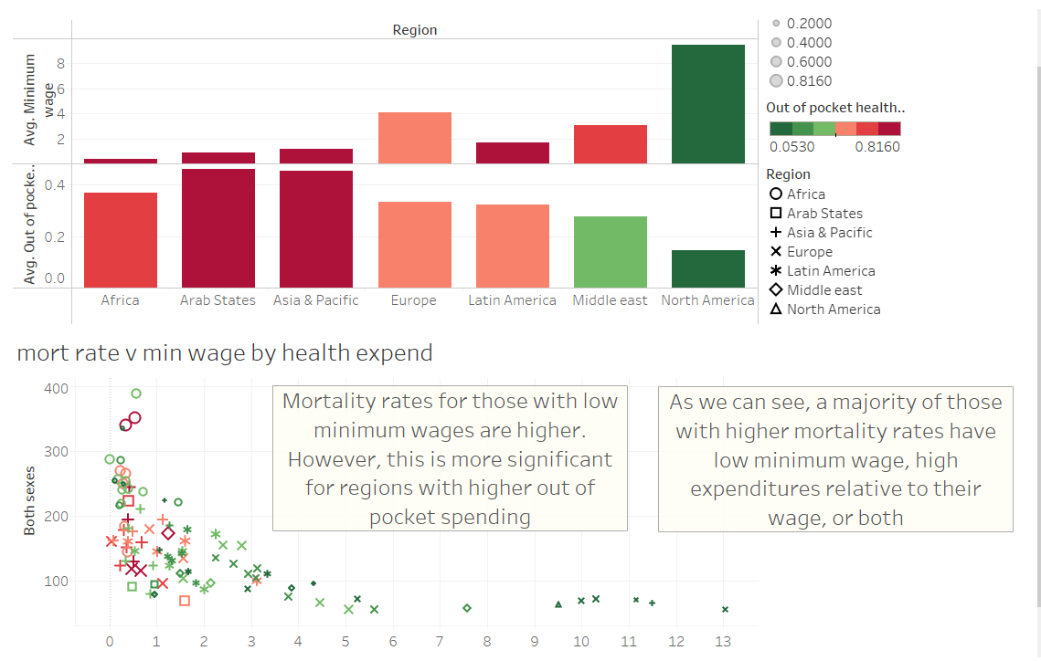
But what about affordability?
Regions with low minimum wages but relatively higher out of pocket health expenditures tend to have higher mortality rates.

Slide 10
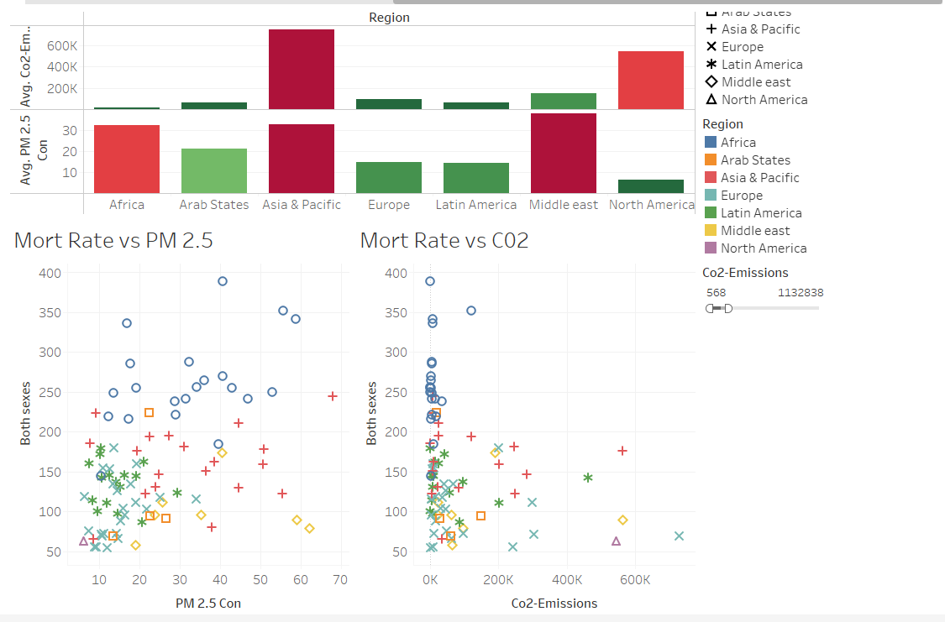
How about factors that affect everyone?
The air quality seems to have an effect on the mortality rates.
Excluding a few outliers that may skew the results, both PM 2.5 and CO2 emissions have some correlation.

Slide 11
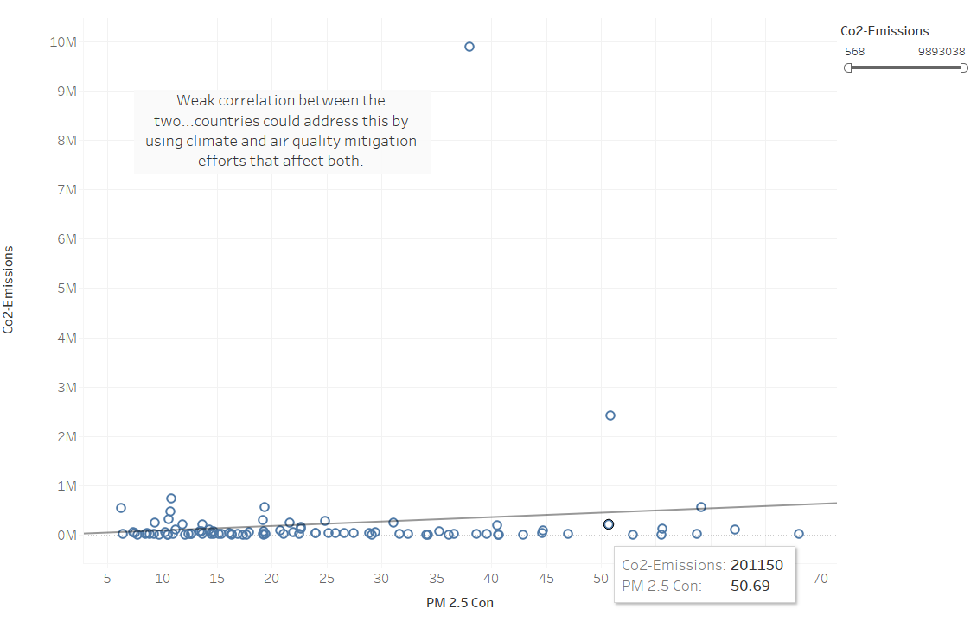
Remedial Efforts
There is a small, but existing correlation between CO2 emissions and PM 2.5 concentrations.

Slide 12
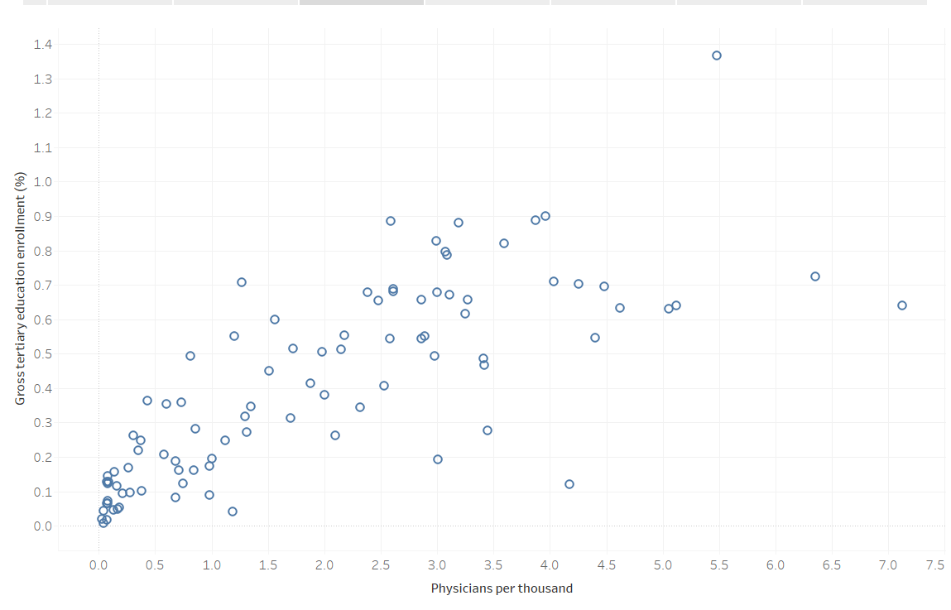
Remedial Efforts (2)
As established earlier, physicians per thousand increase as tertiary education enrollment ratios increase.

Slide 13
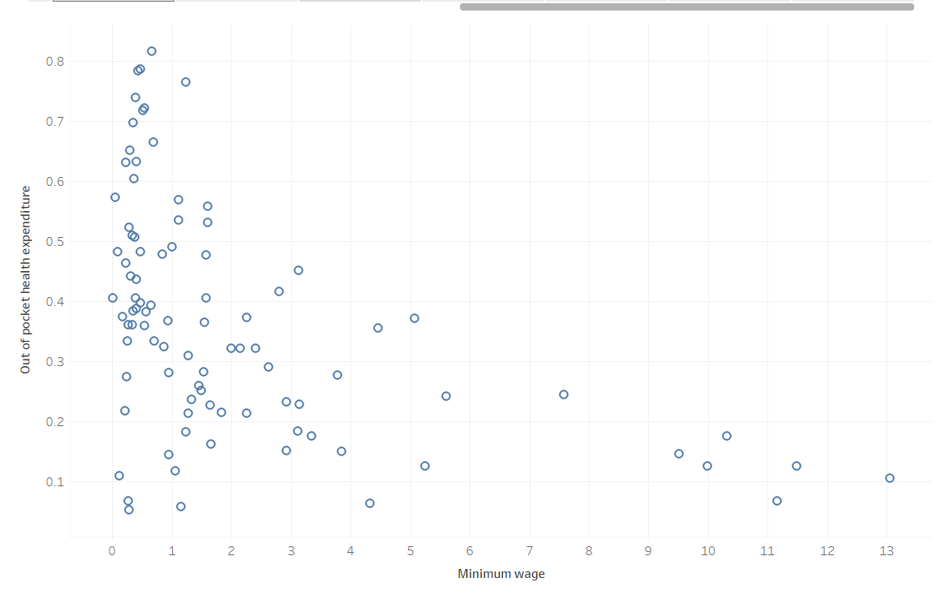
Remedial Efforts (3)
Out of pocket health expenditures seem to decrease as minimum wage increases.

Slide 14
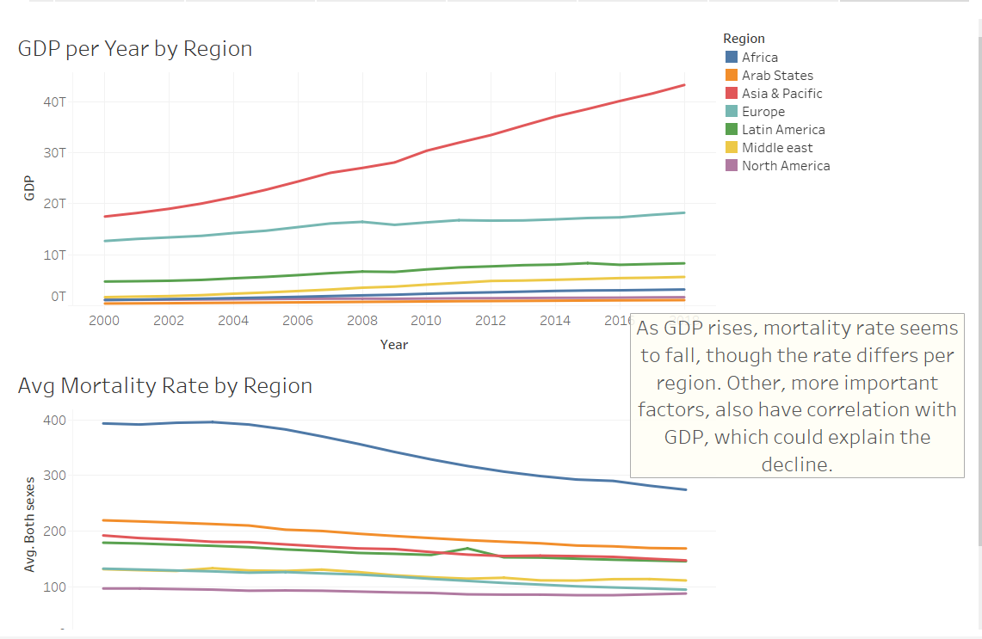
Mortality Rates are Falling
GDP is rising and mortality rates are falling.

